Slide 1



ETL-Dasboard Report
View in Power BI
Last data refresh:
14-08-2022 23:49:09 UTC
Downloaded at:
14-08-2022 23:52:16 UTC

Slide 2
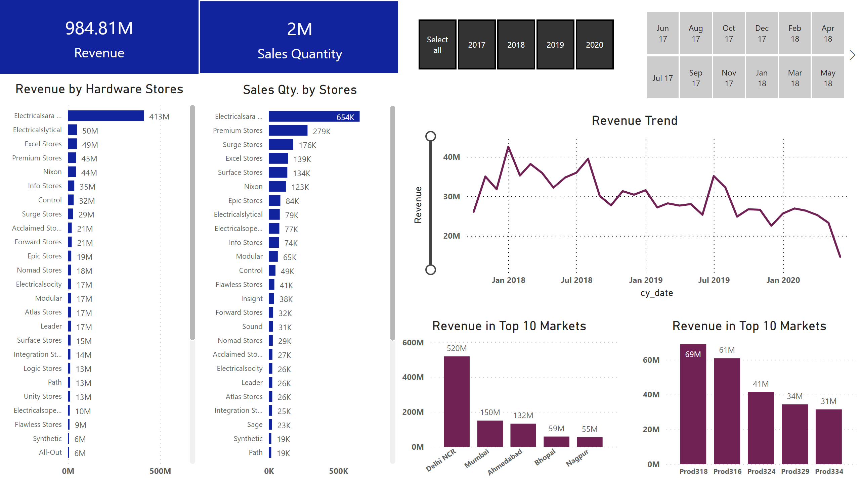
Page 1
Notes:
card
Total Revenue
Revenue by Hardware Stores
No alt text provided
card
Total Revenue
Sales Qty. by Stores
No alt text provided
Revenue by Hardware Stores
No alt text provided
slicer
No alt text provided
Revenue Trend
No alt text provided
Revenue in Top 10 Markets
No alt text provided
slicer
No alt text provided
Revenue in Top 10 Markets
No alt text provided

